Slide 1
Use of IT in Anti-Fraud Efforts & Empanelment for Bihar (Work flow diagram & Implementation till 17th April 2025)
AB-PMJAY (Bihar) in collaboration with ADRI

Slide 2
SHA responsibilities on fraud detection
SHA
Develop institutional structures
Adapt and approve state anti-fraud policies and guidelines
Develop IT system
Conduct anti-fraud awareness
Develop and implement mechanisms for preventing and detecting all kinds of fraud under PMJAY
Data analytics
Contract design, management and enforcement
Data architect by ADRI
(Data mining and Data analytics)
[Materials taken from Microsoft Word - Anti-fraud PMJAY Guidelines- Released-Aug 27 .docx (ayushmanup.in)]

Slide 3
Initial plan for designing dashboard on AB-PMJAY Bihar fraud detection (From ADRI) based on four options
Patient Admitted in Watchlist Hospitals
High value claims
Hospital Bed Cases
Family ID Cases
Geographic Anomalies
Ophthalmology (Cataract)

Slide 4
Data mining architect done based on the following criteria’s
District wise flagged cases
Patient Admitted in Watchlist Hospitals
Overall analysis
Flagging the cases from suspicious hospital list
Identify the cases who claimed larger than 1 Lakh in Surgery Department
High value claims
Case-wise analysis
Identify the cases who claimed larger than 25,000 in Medical Department

Slide 5
Mapping with number of daily admissions of the hospital and the bed strength of the hospital.
If (Number of admissions > bed strength) then mark.
Hospital bed
Part A
No more than 30 cases per OT per Surgeon
Ophthalmology (Cataract)
Part B
Pre-auth time between 8 AM to 6 PM
Part C
The patient’s age should be less than 40 years
Emergency
Emergency in cataract, Oncology, Dialysis
Multiple usage of ID
Same day, same family ID with more than 2 cases
Case-wise analysis

Slide 6
Geographic anomalies
Mapping between patient’s state with treatment in different geographic location
Case-wise analysis

Slide 7
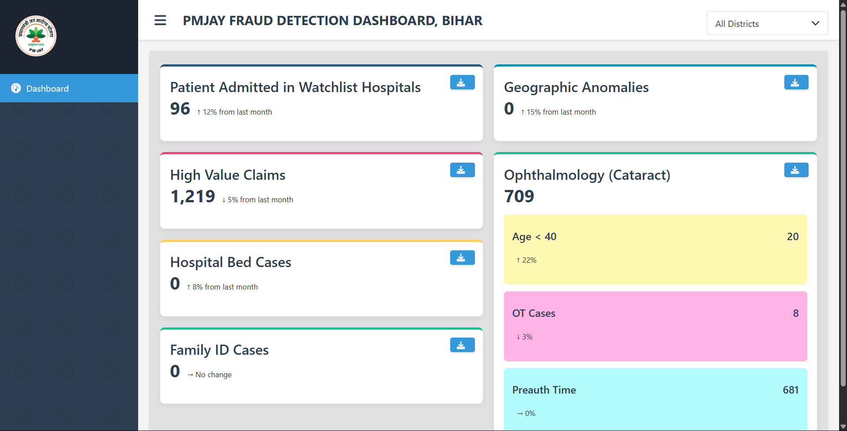
Snapshot for dynamic dashboard created till date
Reflected cases can be downloaded
Fig2: Snapshot of dashboard displaying the necessary data

Slide 8
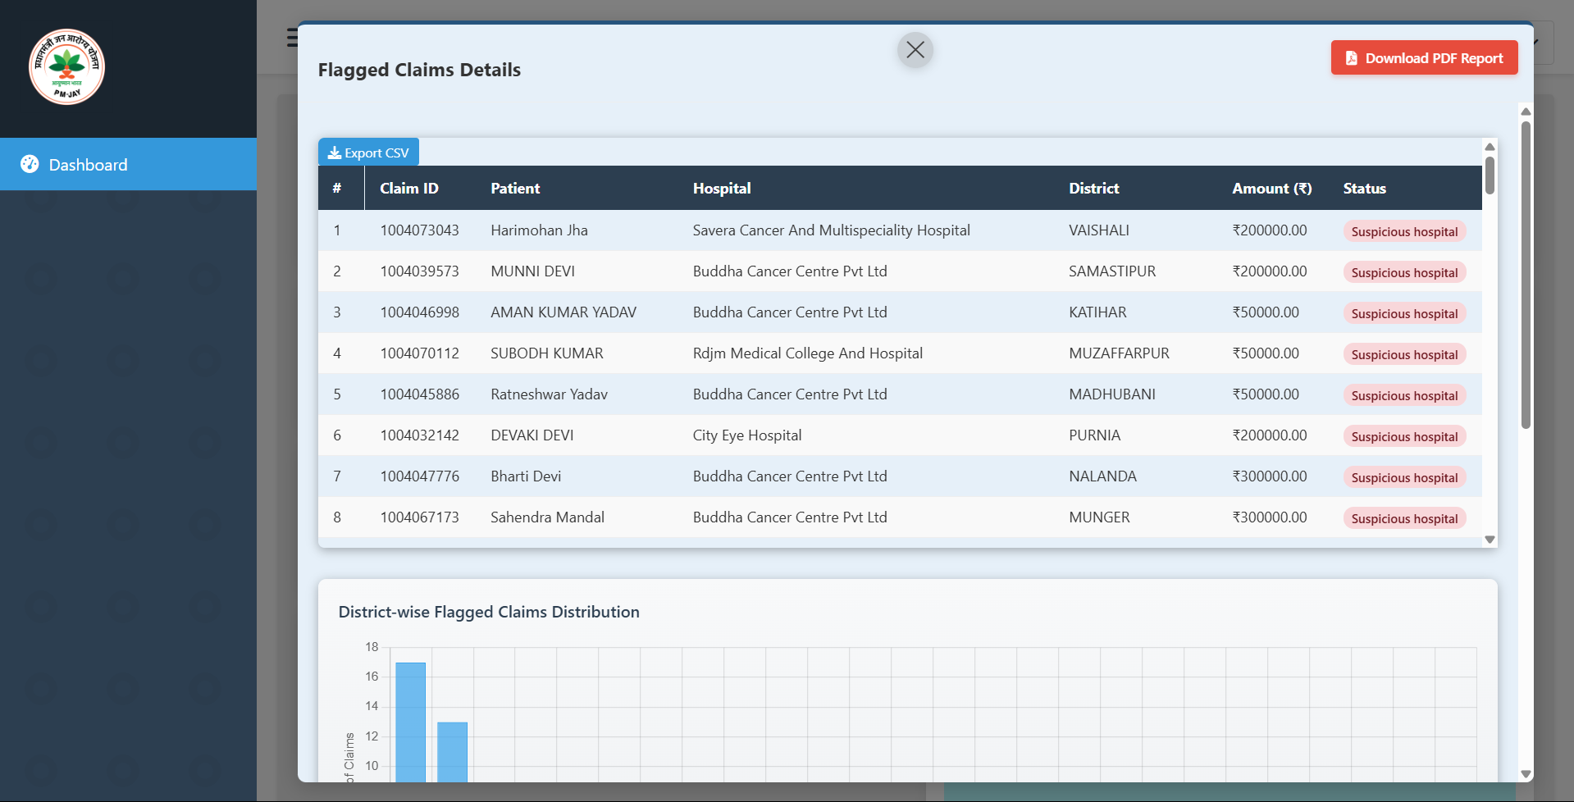
Snapshot for dynamic dashboard created till date
Case Wise Visualization Page
Fig3: Snapshot of case-wise visualizations page

Slide 9
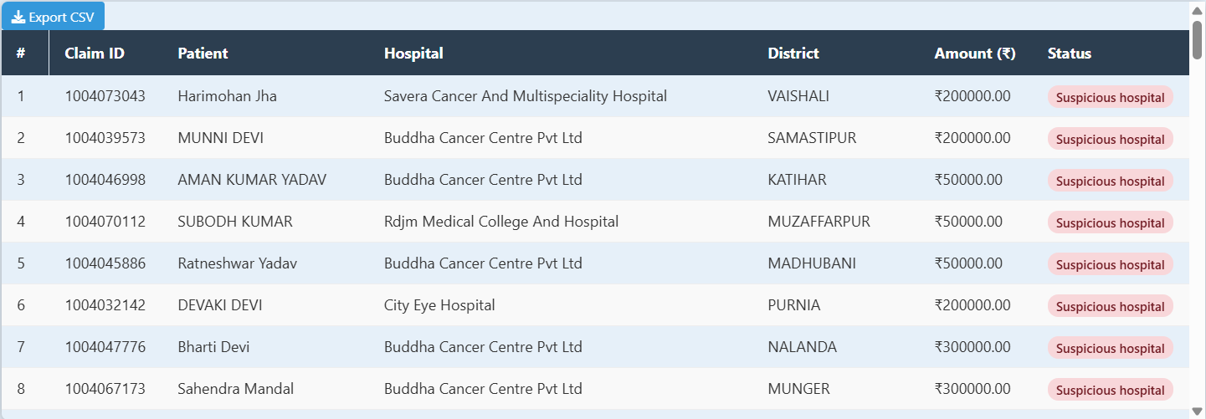
Snapshot for dynamic dashboard created till date
All flagged patient details
Fig4: Snapshot of table visualization

Slide 10
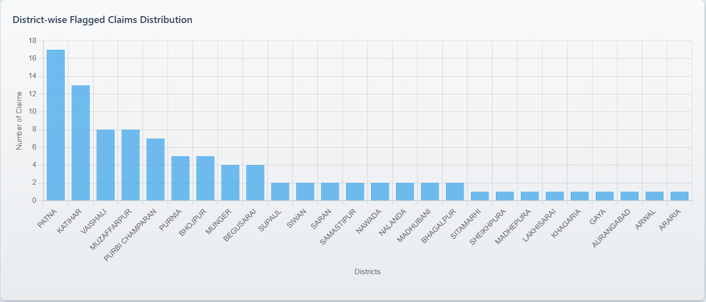
Snapshot for dynamic dashboard created till date
Bar Chart representation (District-Wise)
Fig 5: Snapshot of bar-chart visualization

Slide 11
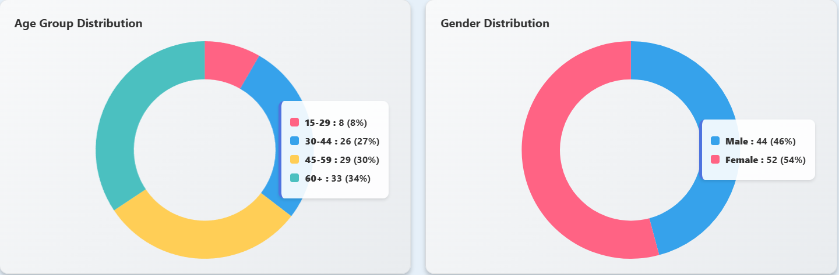
Snapshot for dynamic dashboard created till date
Pie-Chart representation (Age Groups and Gender Distribution) (District-Wise)
Fig 6: Snapshot of dashboard displaying the pie-chart representation of two aspects: “Age-Groups” and “Gender Distribution” and district-wise

Slide 12
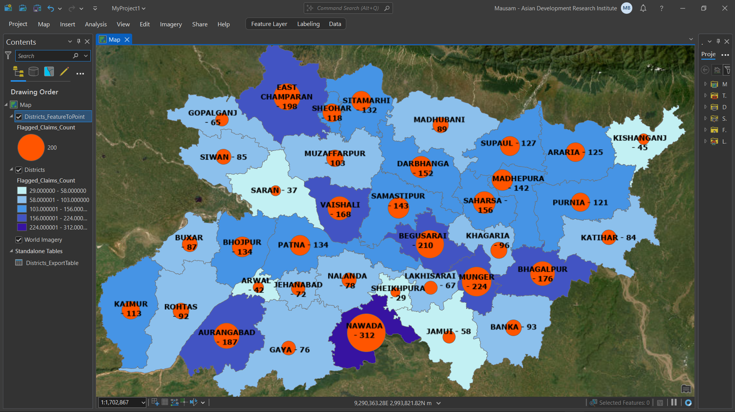
Snapshot for dynamic dashboard created till date
Heat-Map representation
Fig 7: Snapshot of development of the heat-map representation district-wise

Slide 13
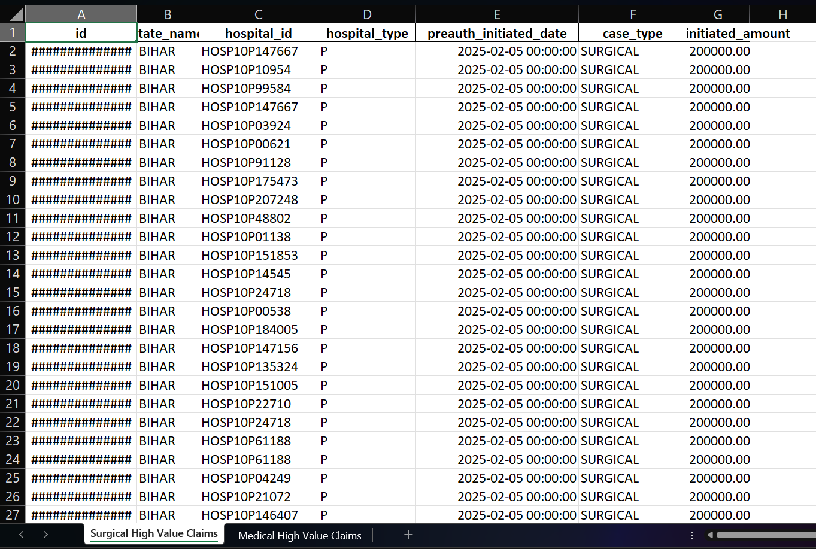
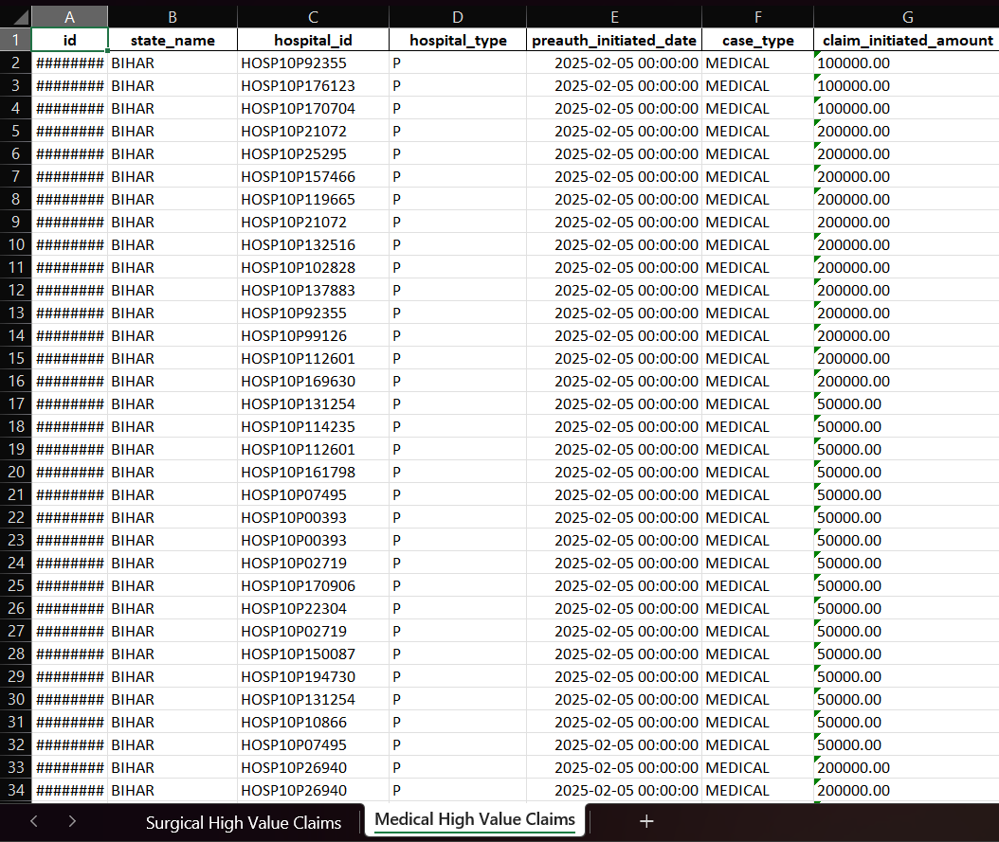
Downloaded data (snapshot)
Fig8: Snapshot of downloaded data of “High Value Claims” having two separate sheets: “Surgical” and “Medical”

Slide 14
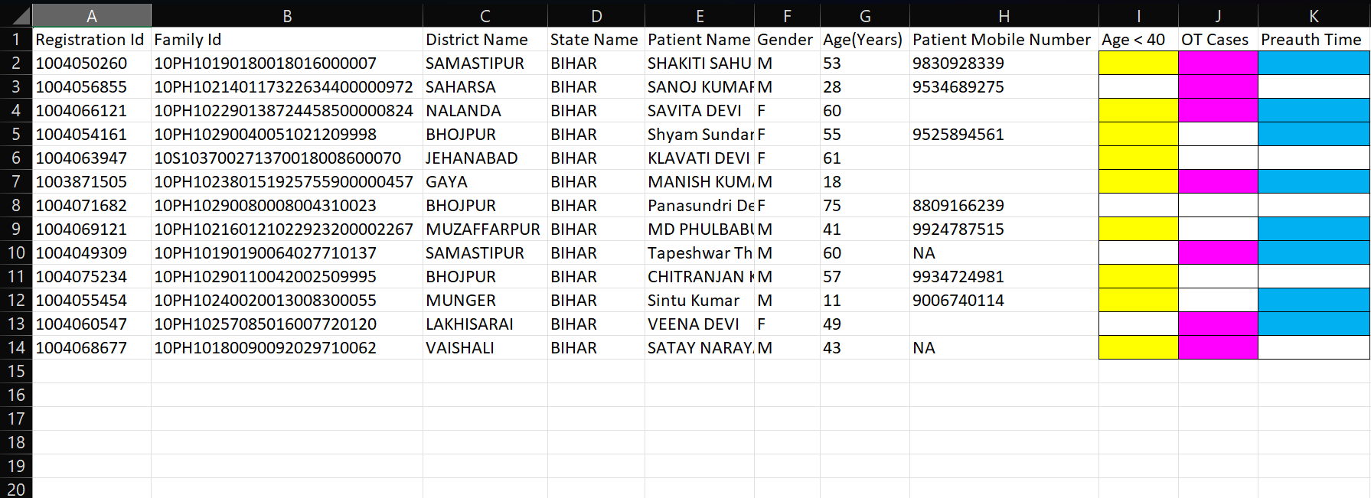
Downloaded data (snapshot)
Fig8: Sample snapshot of downloadable data of “Ophthalmology (Cataract)” having color coded results for Age less than 40(Yellow), OT Cases(Magenta), and Pre-auth Time(Cyan)

Slide 15
Future work (Yet to start the implementation)

Slide 16
PM-JAY “Empanelment”
SHA role on Empanelment
Awareness among the healthcare service providers
Verification & Approval
ADRI working as a collaborative partner
Healthcare Service Provider Landscape
Done by SHA

Slide 17
Workflow for Dashboard on Hospital Empanelment
Categorize log in facility
CEO (Read/edit)
Medical Doctor (Read)
District level officer (Read)
Total number of hospital available district wise
Categorization among the hospitals
Speciality wise
Total number of specialist doctor available
Bed strength wise
Mandatory documents verification information
Clinical Registration
Fire NOC
Bio-Medical authorization
Pop-up will appear on the lapse of expiry date for the mandatory documents

